Slide 1
MSD Project
Team 1

Slide 2
Project Overview
The goal was to create a backend microservice architecture for a pre-built React front-end
Allows a user to register a new account in the Event Registration application for the Metropolitan Convention Center
Within this app, a user can also manage events and registrations
This involved the creation of two microservices – one for authentication and one for data manipulation

Slide 3
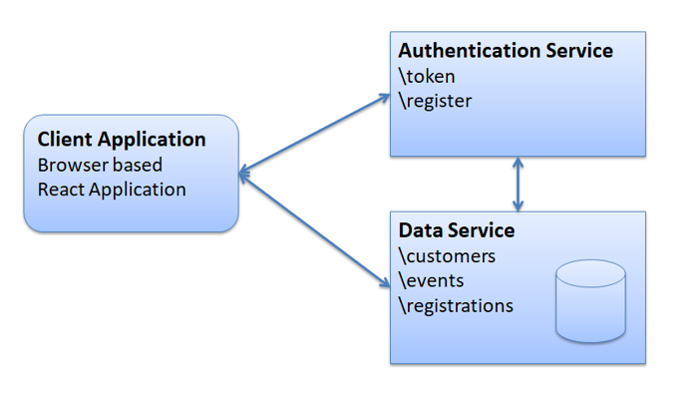
Architecture/Design
Client Application
React front-end provided
Authentication Service
Uses JWT and communicates with the Data Service
Data Service
In-memory database

Slide 4
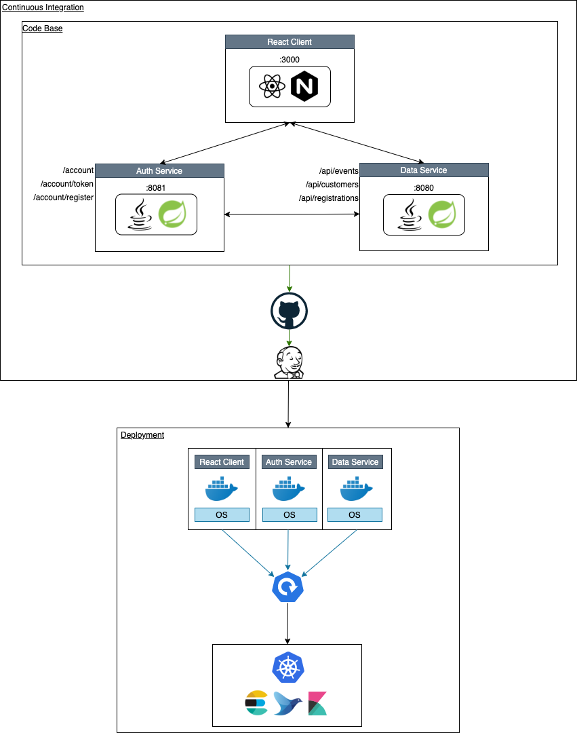
Architecture/Design
Jenkins
Auth and Data services have their own CI pipeline
Docker
Containerized services for rapid deployment
Kubernetes
Cluster management with dashboard and load balancing

Slide 5

Tools and Software
Java
Spring Boot
GitHub
JWT
Jenkins
Docker
Kubernetes

Slide 6
Challenges
Deployment of docker images using -latest tag
VMs performance
Provided React client had very specific expectations
CI-CD limited due to permissions

Slide 7


Lessons
DevOps collaboration
Spring Boot
Gradle
Docker
Jenkins
Kubernetes
Prometheus
Jaeger

Slide 8
Future Improvements
Security Enhancements
Externalize Database
New and Modern Front-End
Continuous Deployment Pipeline
Metrics

Slide 9

Demo

Slide 10

Questions

